Slide 1
Distribution Case Study
Restricted
A Solutions Design Perspective
DHL Supply Chain
David Zheng

Slide 2
Objective
Design a proposal to provide distribution for retail stores in the Georgia market. The scope of the proposal in to receive, sort, and load trailers and deliver product to it's stores.
Using the Shipment worksheet, Store locations worksheet and the assumptions slide answer the following questions.

Slide 3
Assumptions
Inbound profile:
Inbound trailers are floor loaded
Inbound trailers have <= ten stores per trailer
Inbound shipments are from one origin
Inbound cases are store labeled
Receiving shift 4 Hours
Outbound profile:
Outbound trailers are palletized
45 Cases per pallet
All product is received the day before it is loaded for delivery
Shipping Shift 4 Hours
Delivery:
Fixed routes – same routes run daily
Multiple deliveries per route
30 Minutes per stop
Seven day per week delivery
Deliver between 08:00 – 17:00

Slide 4
Questions
What conclusions can you make about the weekly and daily variability in demand?
What is the best location for the operation?
What size of equipment should be used from the following choices: 26’ Truck, 48’ Trailer, 53’ Trailer
What is the estimated drive time and work time?
What is the estimated number of routes per day?
What is the estimated the number of tractor/trailers or trucks required?
What is the estimated the number of drivers required?
What is the estimate cost per week to operate the fleet (Equipment, Labor, Fuel)?
How many dock doors are required?
How much space is required (SF2)?
How much direct labor (headcount) is needed to unload, sort, stage and load the trailer?
What is the estimate cost per week to operate the cross-dock (Labor, Space, Equipment)?

Slide 5
Data Files
Shipment Data
Shipment Date
Customer Number
Address
City
State
Zip
Weight (Lbs)
Cubic Feet
Cases
Store Data
Customer Number
Address
City
State
Y
X
Data File

Slide 6
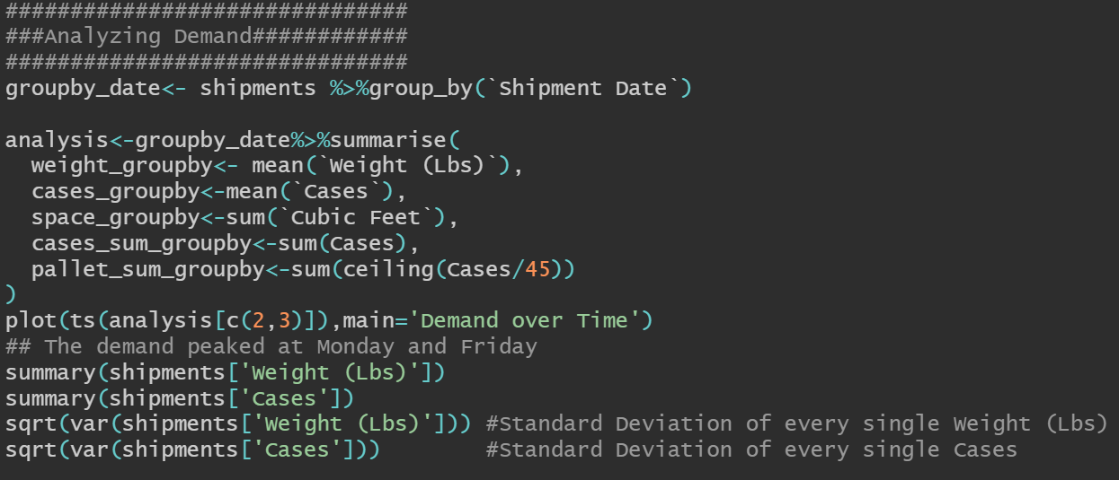
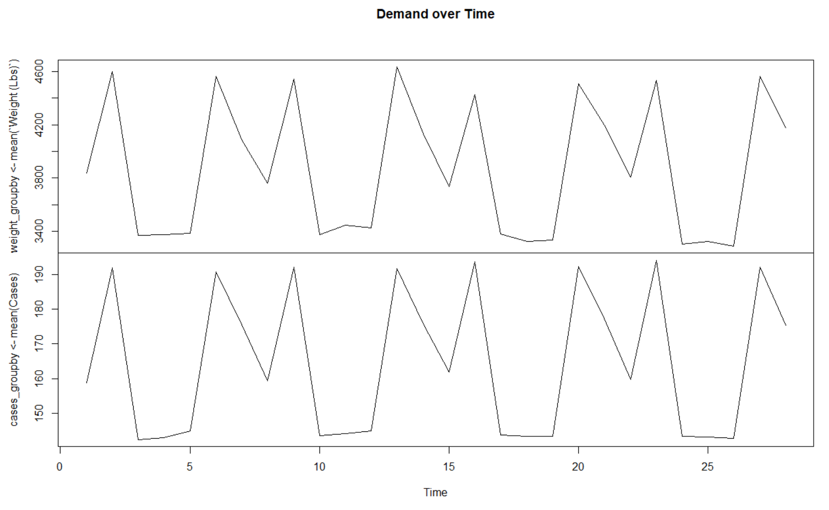
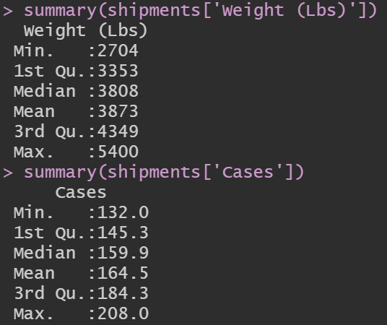
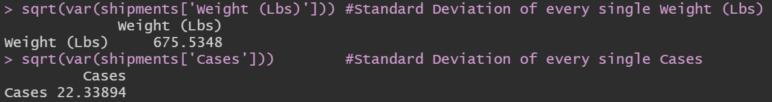
Analyzing Seasonality of Demand using RStudio

Slide 7
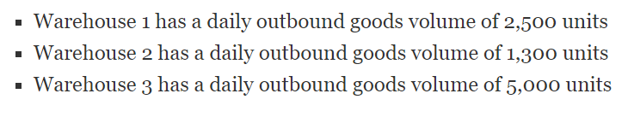
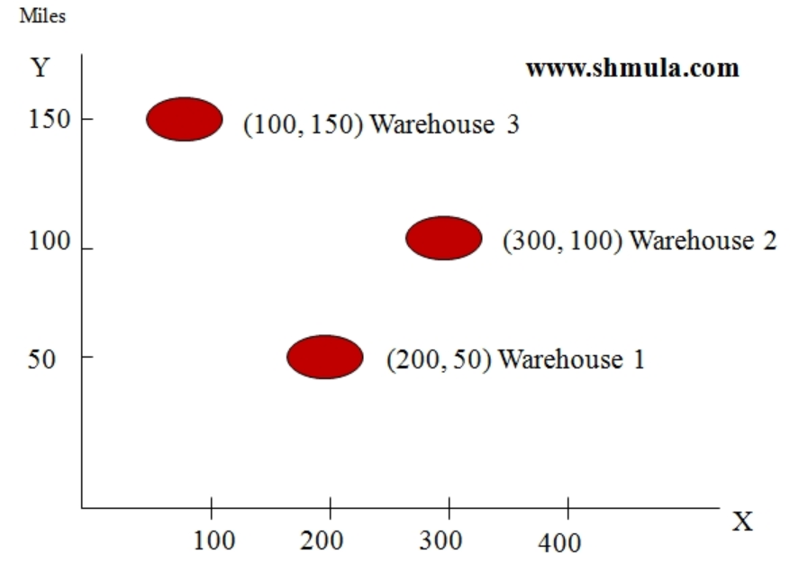
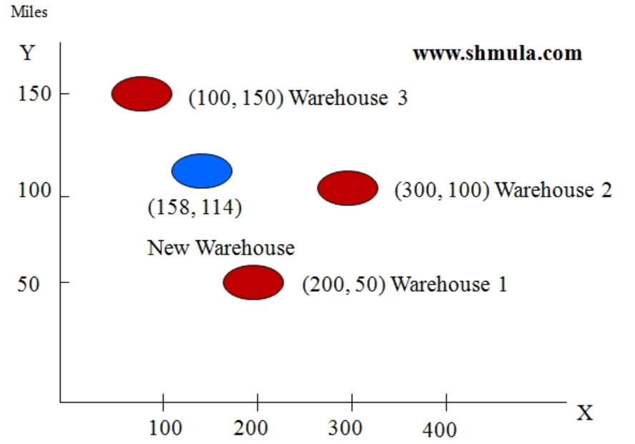
Center of Gravity Method for Facility Location
The center of gravity method is used for locating single facilities that considers existing facilities, the distances between them, and the volumes of goods to be shipped between them.
This methodology involves formulas used to compute the coordinates of the two-dimensional point that meets the distance and volume criteria stated above.
For example:

Slide 8
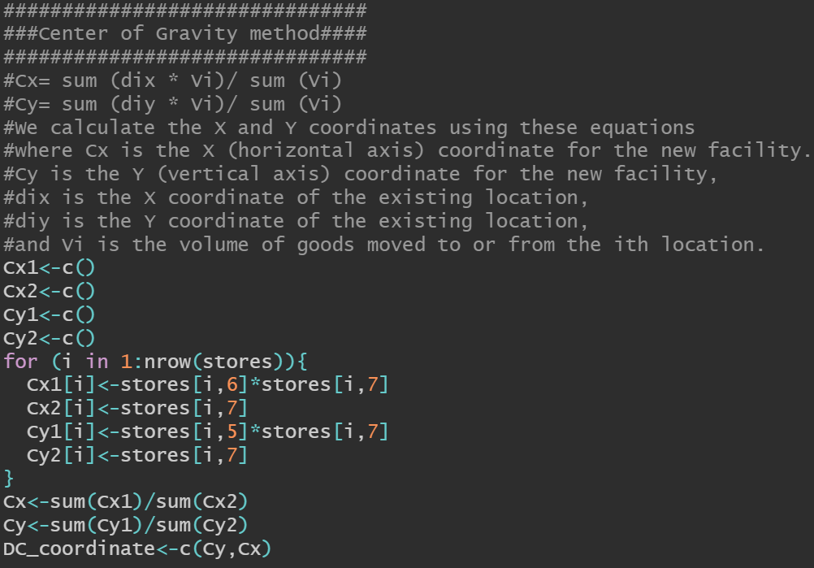
Preparing Inputs for Center of Gravity Method
The Center of Gravity Method takes three inputs,
which is: X, Y coordinates, and demands from each store
However, the demands for each store fluctuate from time
to time
In this case we need a weighted demand that can be a good
representation for inputs.
Instead of calculating the average demand for each store
over 28 days period, Bootstrap Resampling method is used
to better understand the overall population, which is explained
in next slide

Slide 9
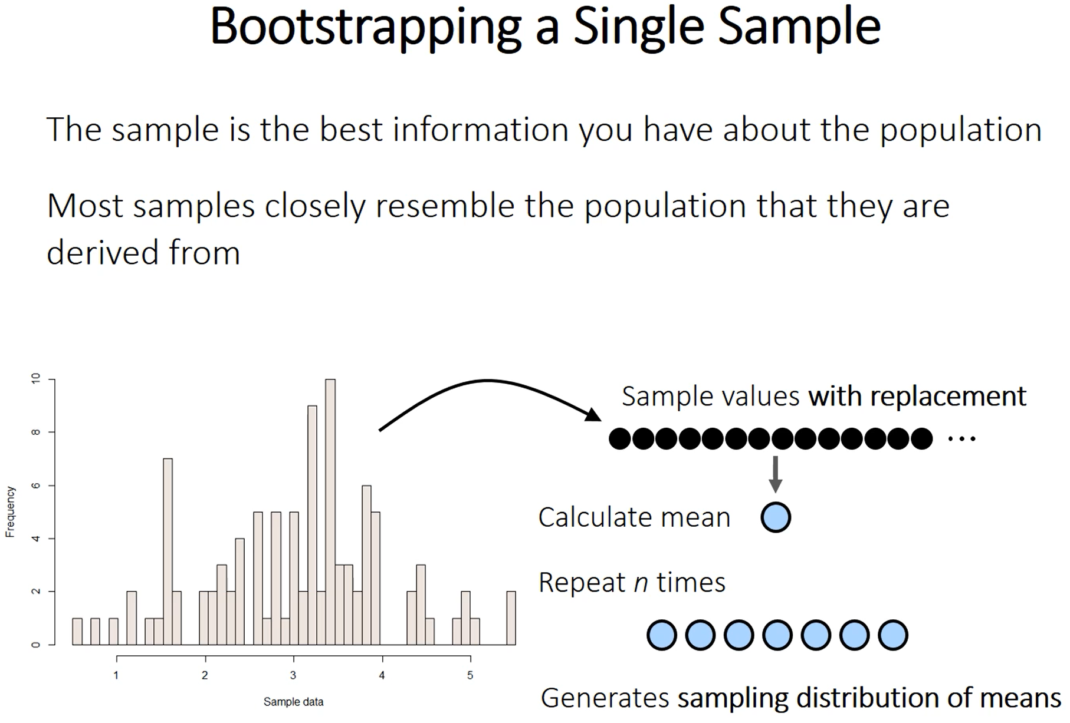
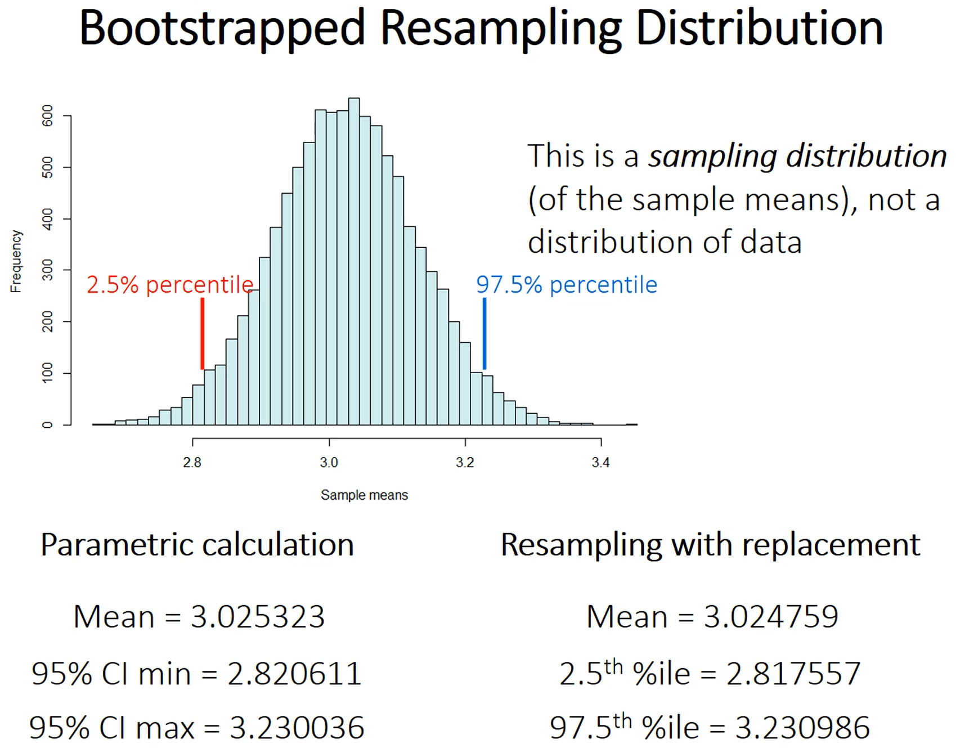
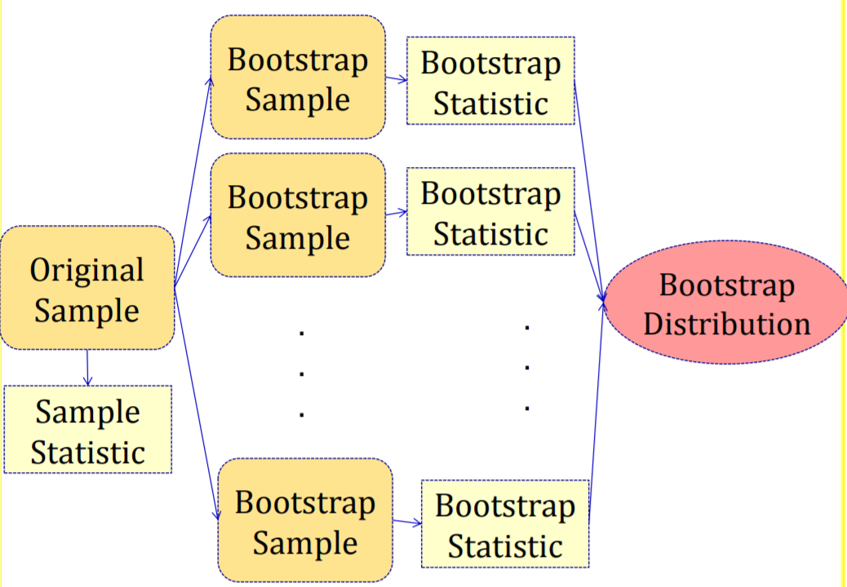
Bootstrap Resampling Method

Slide 10
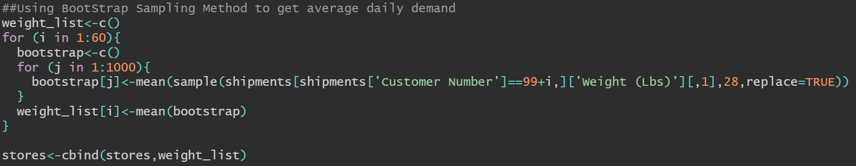
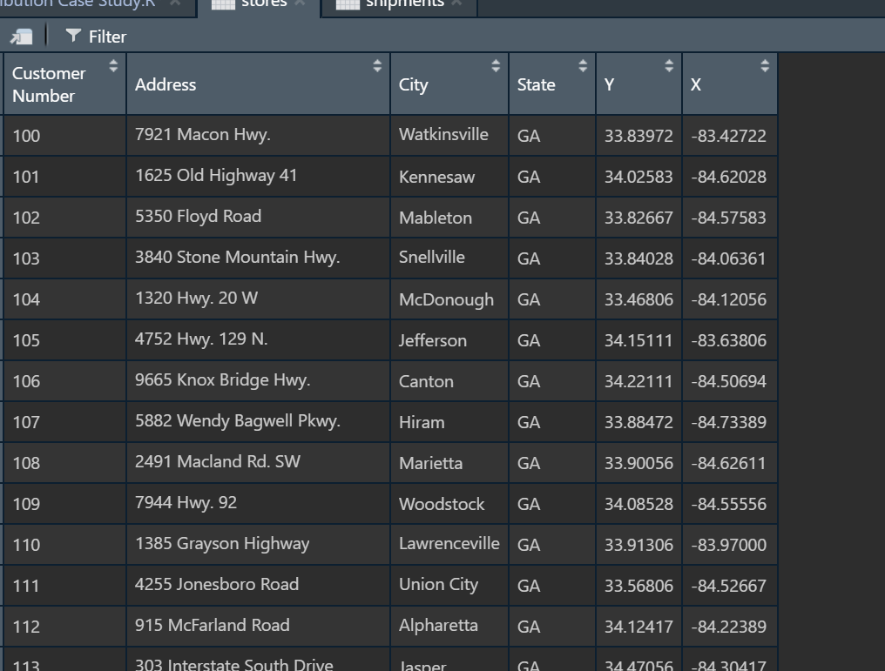
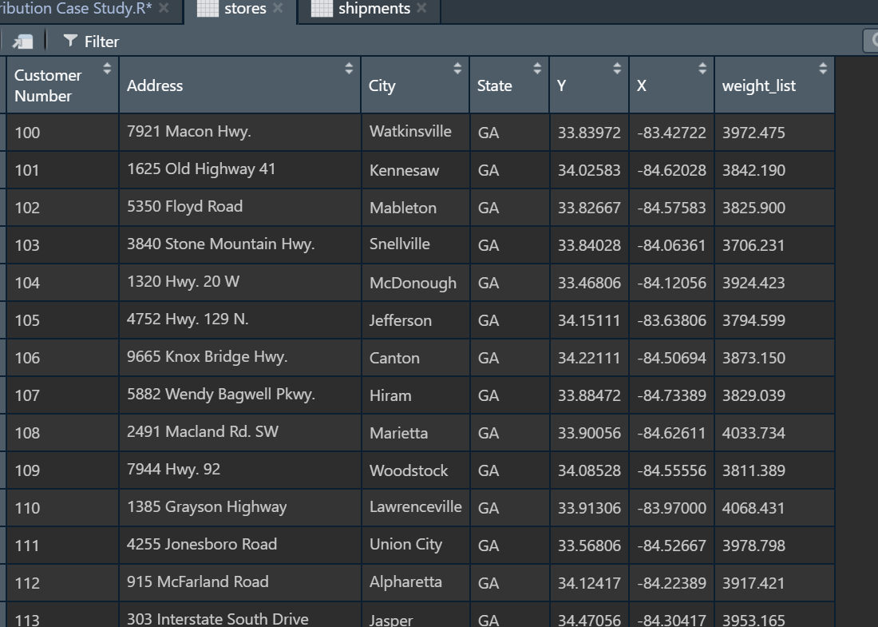
Using Bootstrap Method to Generate Weight_list

Slide 11
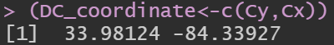
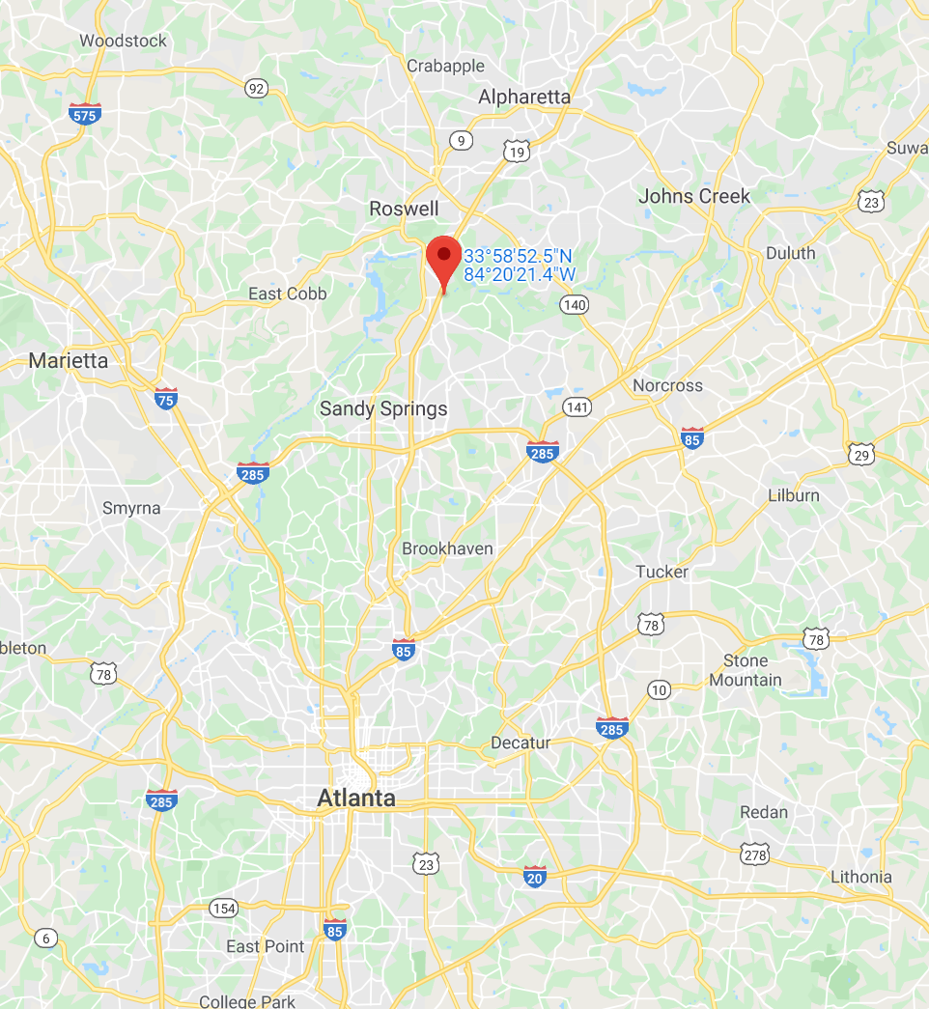
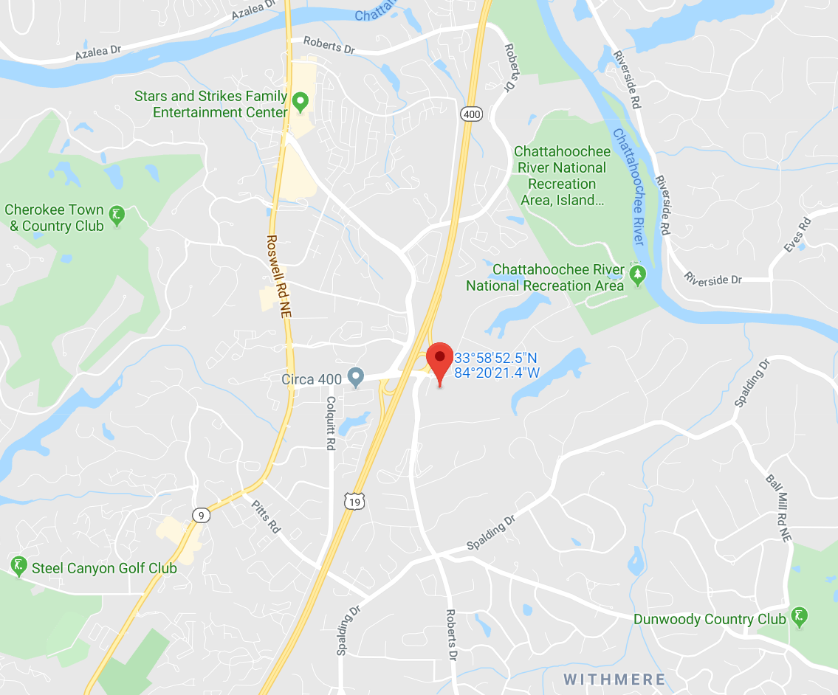
Cross-docking Warehouse Location
Now we have located the warehouse, the next step is to solve the Traveling Salesman Problem.

Slide 12
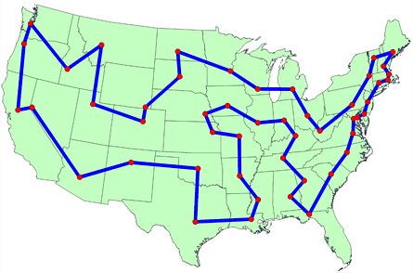
Solving The Traveling Salesman Problem
--"Given a list of cities and the distances between each pair of cities, what is the shortest possible route that visits each city and returns to the origin city?“
The traveling salesman problem is one of the most intensively studied problems in computational mathematics.

Slide 13
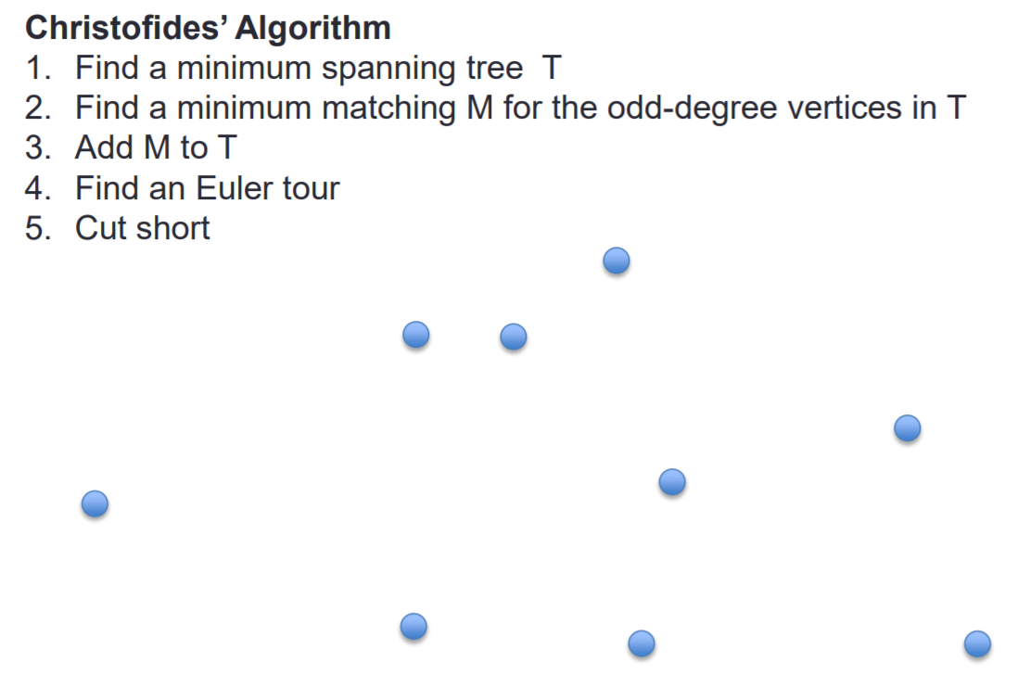
Solving The Traveling Salesman Problem Using Christofides Algorithm
The Christofides Algorithm is an algorithm for finding approximate solutions to the Travelling Salesman problem, on instances where the distances within each point form a metric space. It is an approximation algorithm that guarantees that its solutions will be within a factor of 3/2 of the optimal solution length.
As of 2019, this is the best approximation ratio that has been proven for the traveling salesman problem on general metric spaces, although better approximations are known for some special cases.

Slide 14
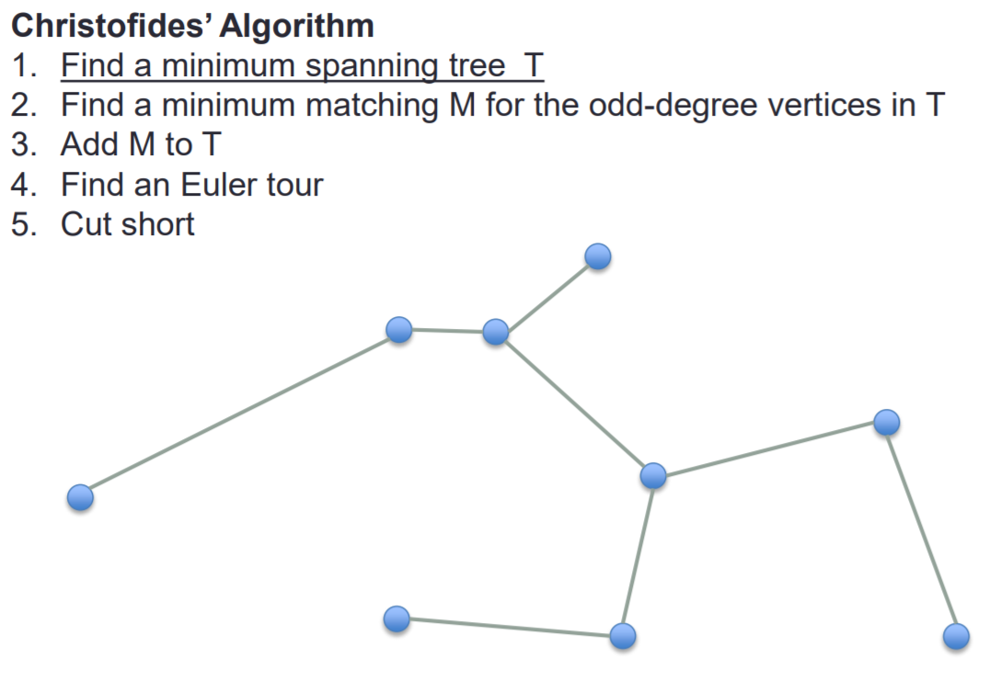
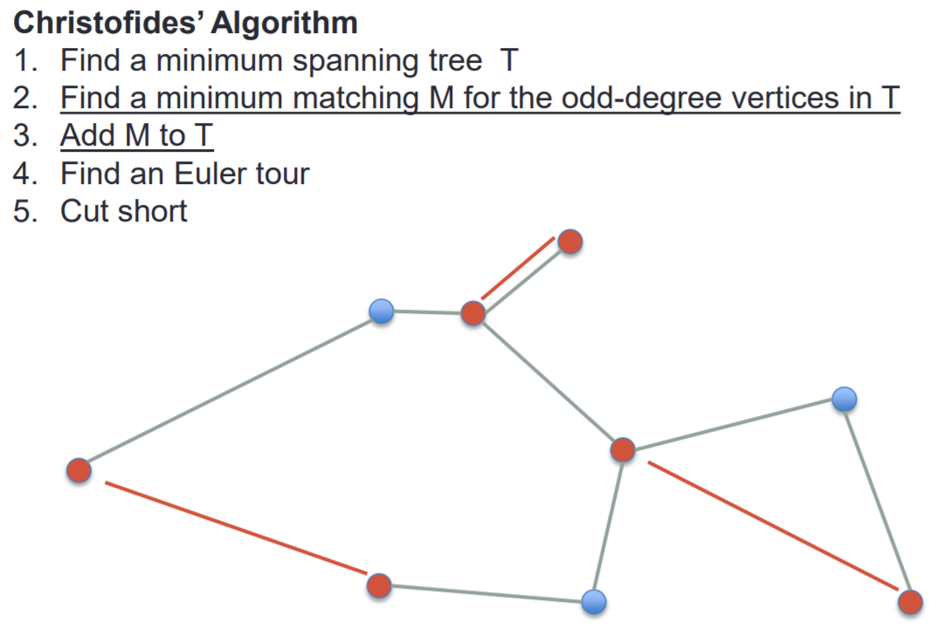
Solving The Traveling Salesman Problem Using Christofides Algorithm

Slide 15
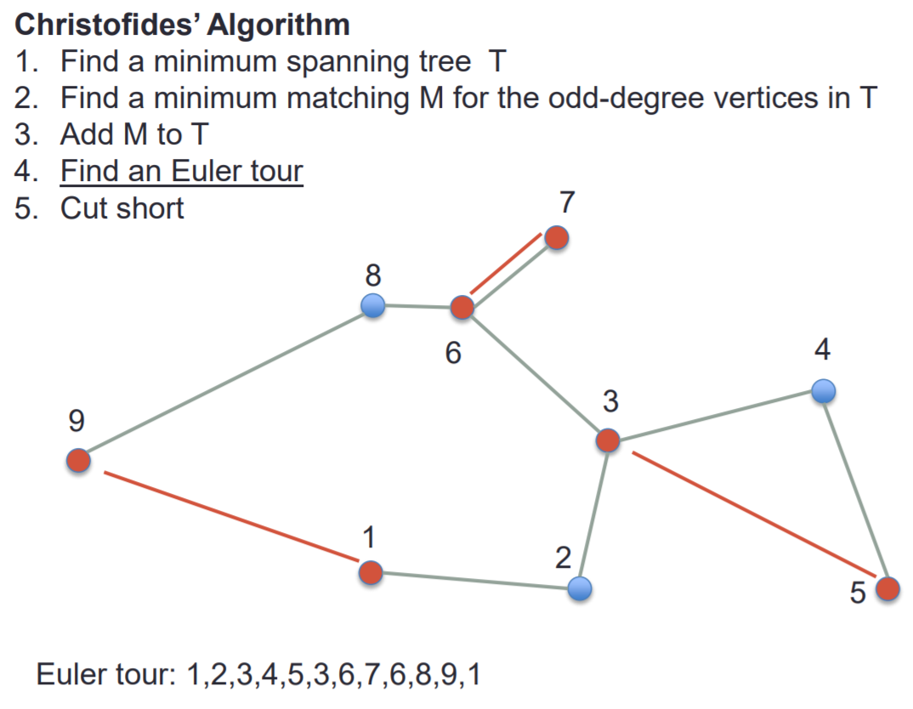
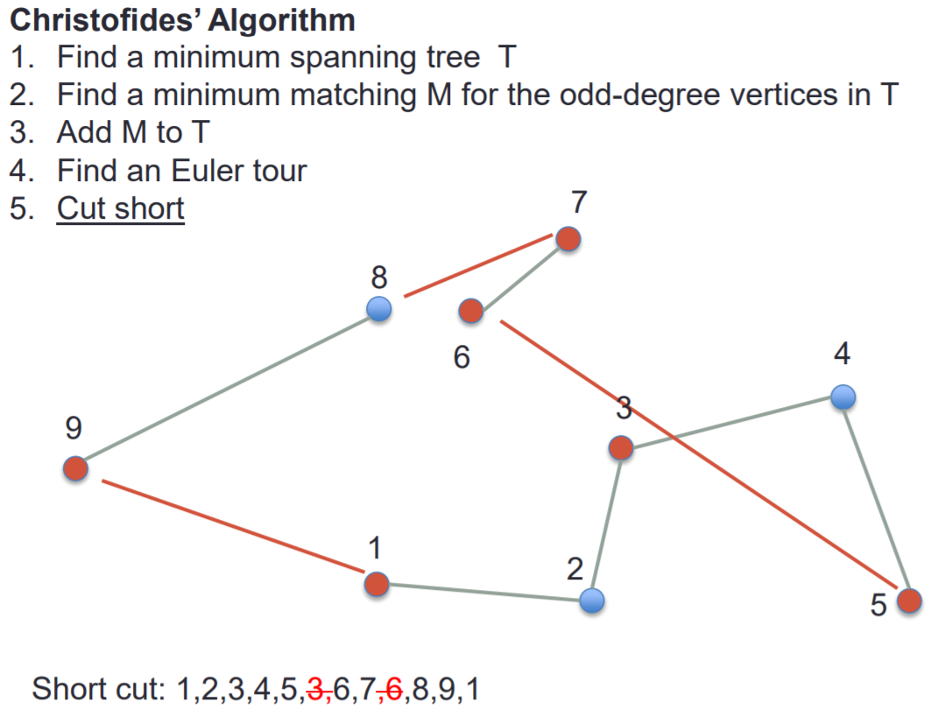
Solving The Traveling Salesman Problem Using Christofides Algorithm

Slide 16
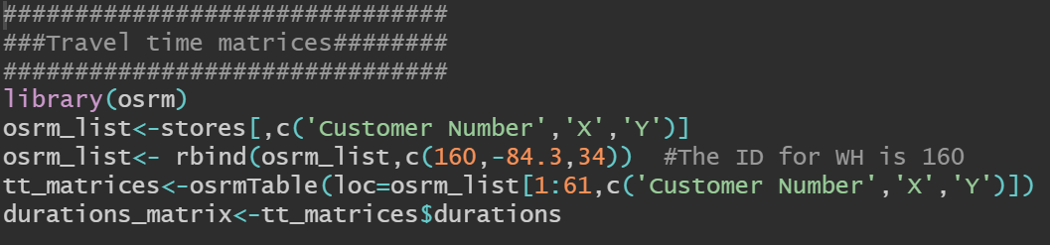
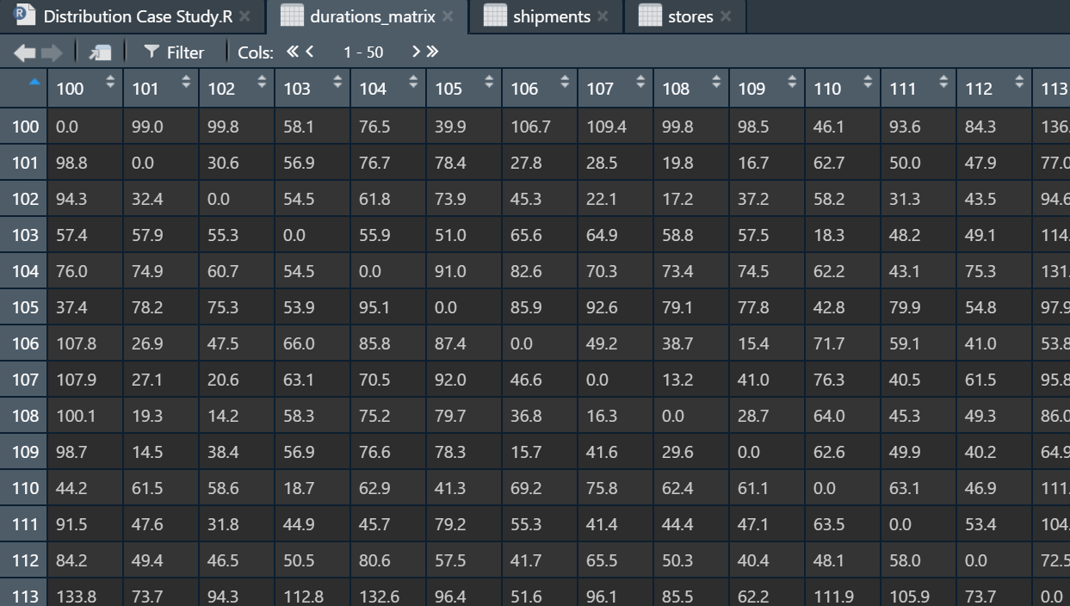
Travel Time Matrix using OSRM Package
Instead of using X,Y coordinates to calculate Euclidean distance(Direct line distance) or Haversine distance(Direct distance integrated with the curvature of earth), OSRM package is used to generate the Travel Time Matrix
OSRM is a routing service based on OpenStreetMap data. This package allows to compute travel time between points and travel time matrices.

Slide 17
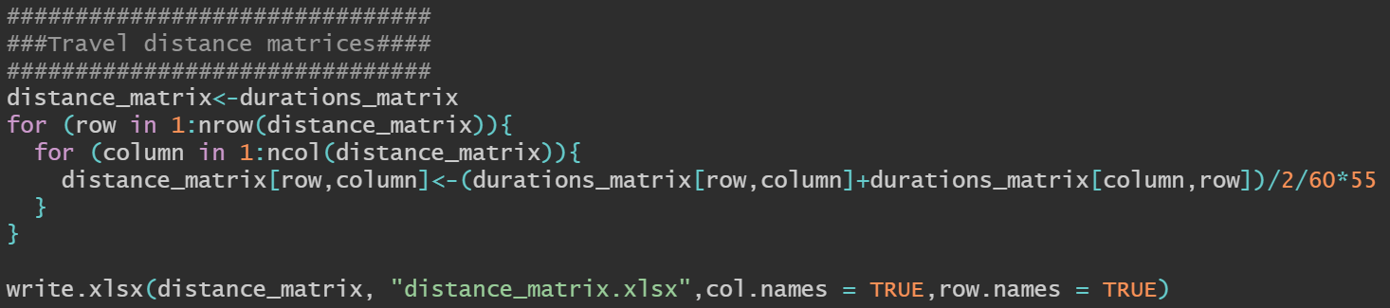
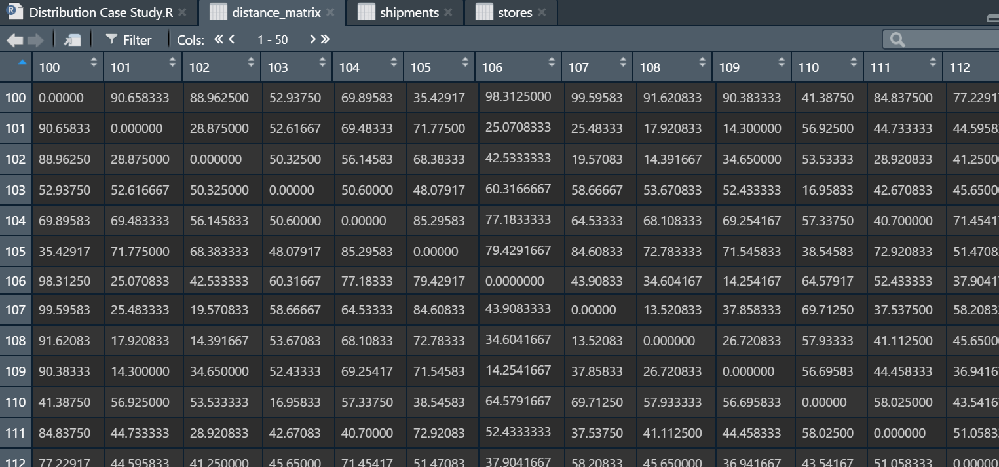
Generate Distance Matrix from Travel Time Matrix
Distance Matrix is generated based on Travel time Matrix, where the average truck driving speed is assumed as: 55mph

Slide 18
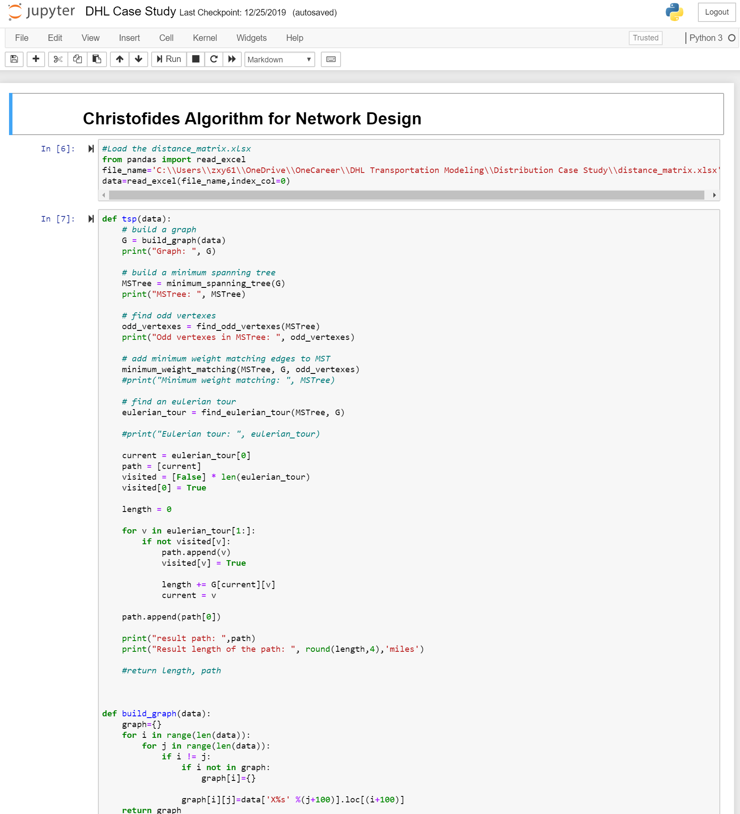
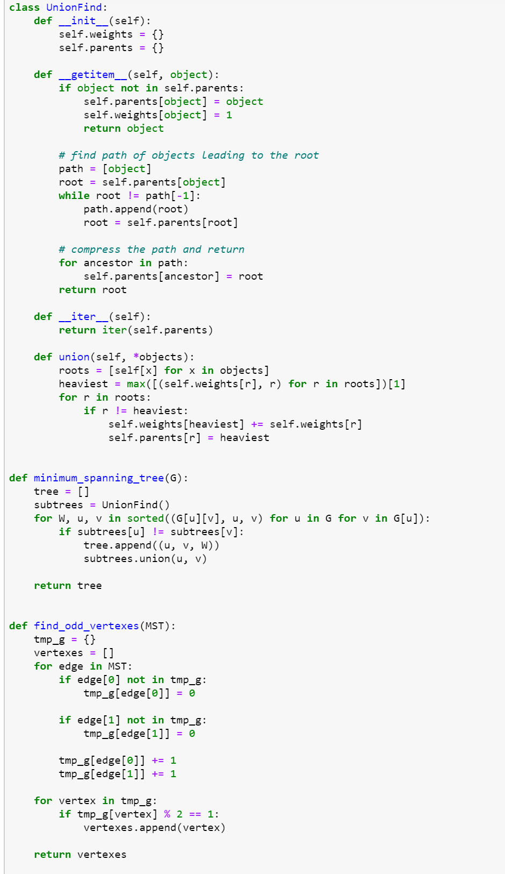
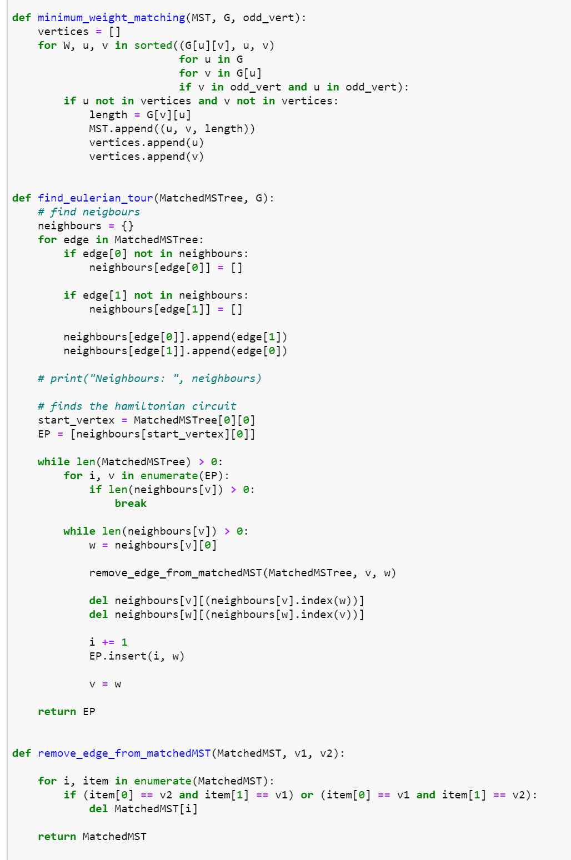
Define Christofides Algorithm Function

Slide 19
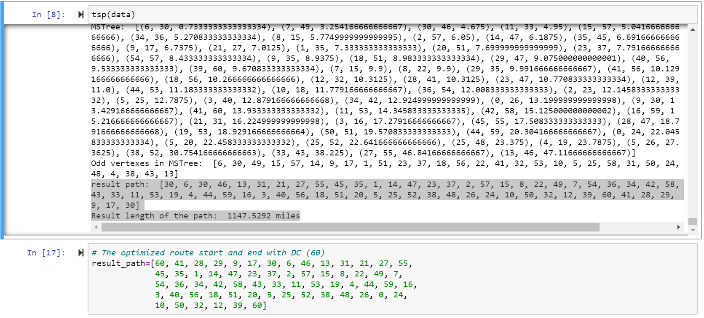

Solving Traveling Salesman Problem using Christofides Algorithm

Slide 20
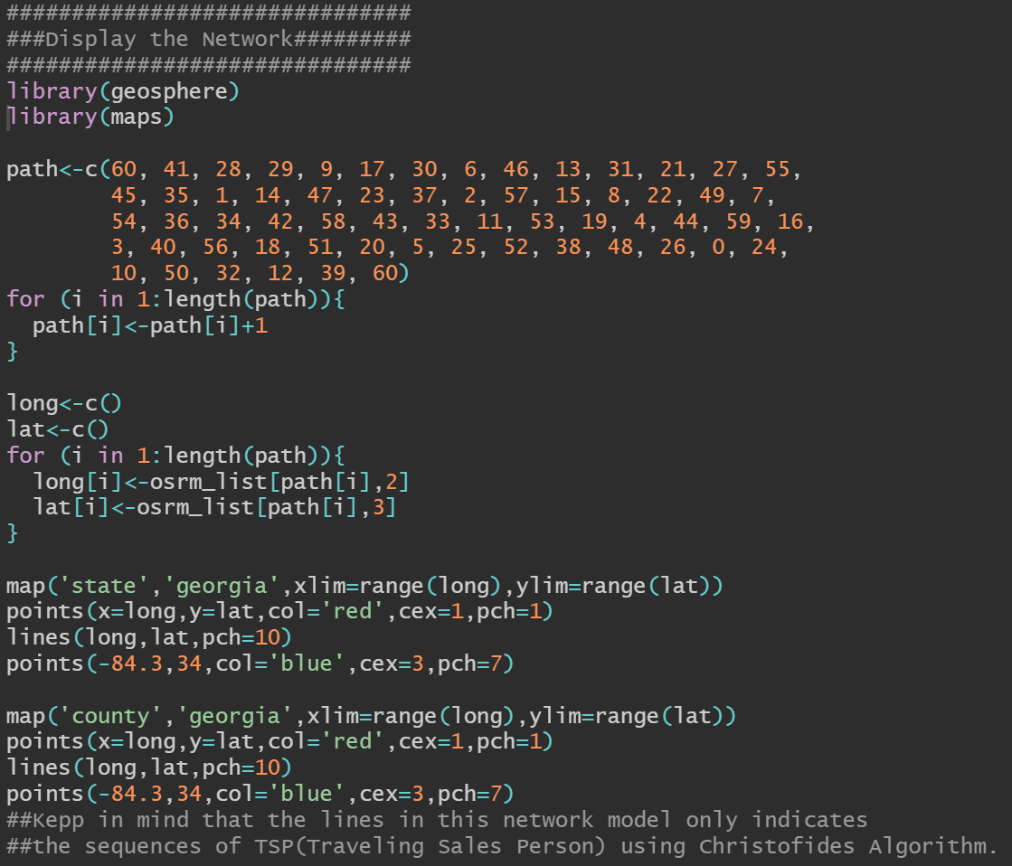
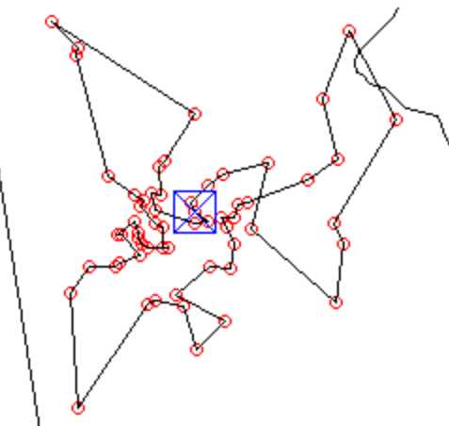
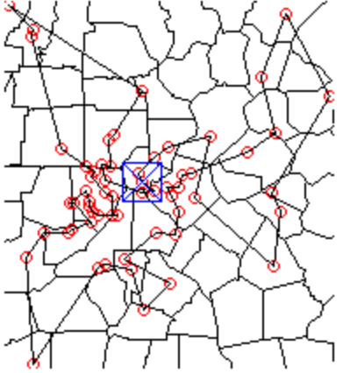
Display the Network
TPS in State Map
Keep in mind that the lines in this network model only indicates the sequences of TSP
TPS in County Map

Slide 21
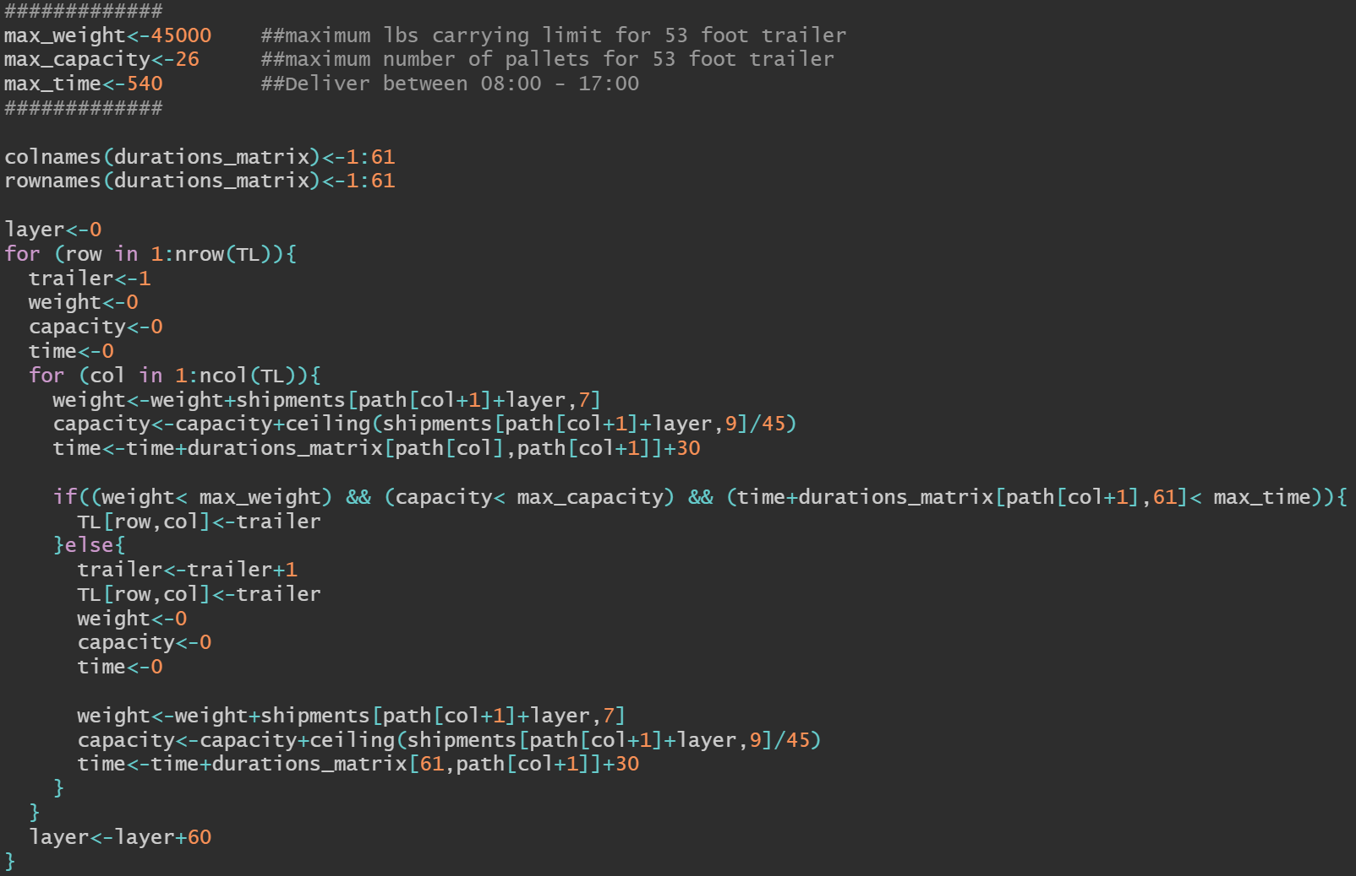
Assign LTL to The Network
In this case, multiple 53 foot trailers are assigned to split and to fulfill the TSP network, and each single trailer follows same constraints:
The maximum load for each trailer is 45,000 lbs
The maximum number of pallets can be fitted per trailer is 26
The maximum operation time is limited within 540 minutes which includes the driving time to fulfill the delivery, 30 minutes per stop, and time it takes to return from final delivery store back to the warehouse

Slide 22
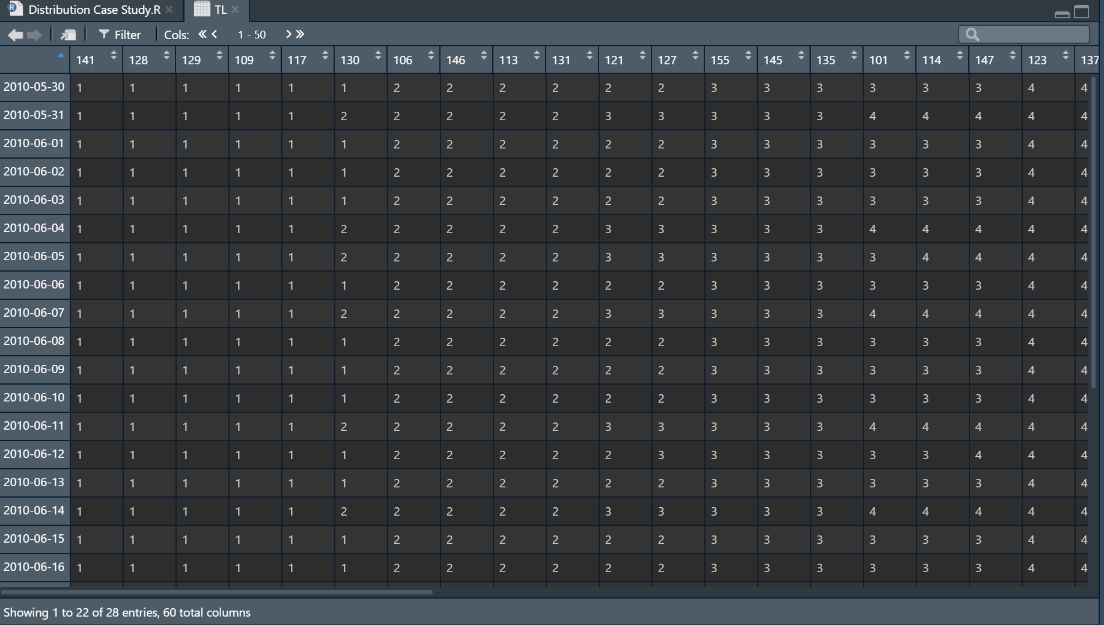
Less Than Truck Load Assignment
Columns indicates the sequences of store_ID that TSP network cover.
Rows indicates the fulfillment date
Numeric number in each row indicates the truck_ID that is assigned to fulfill each designated store

Slide 23
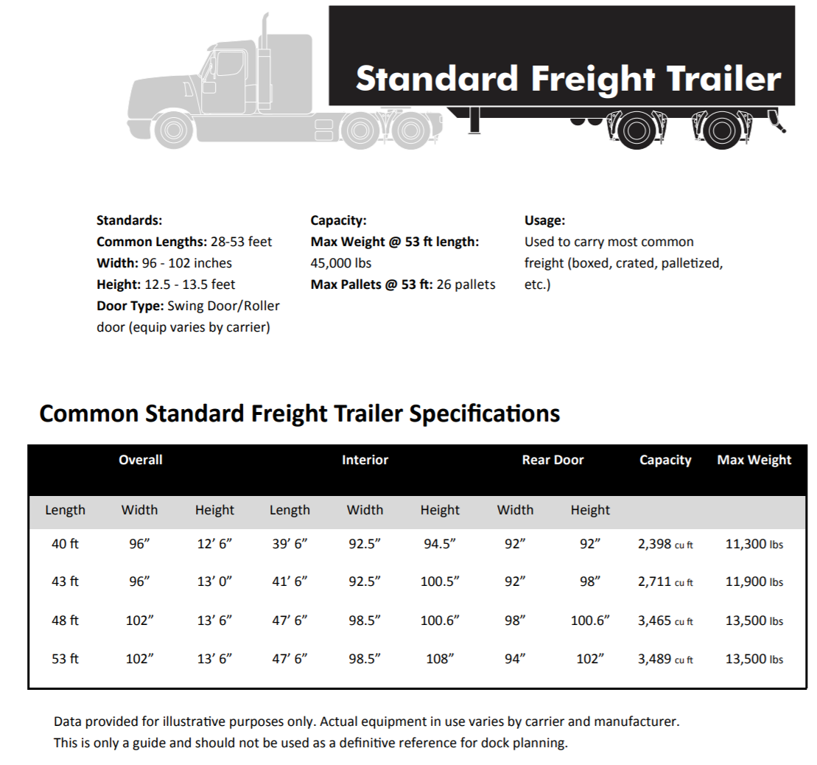
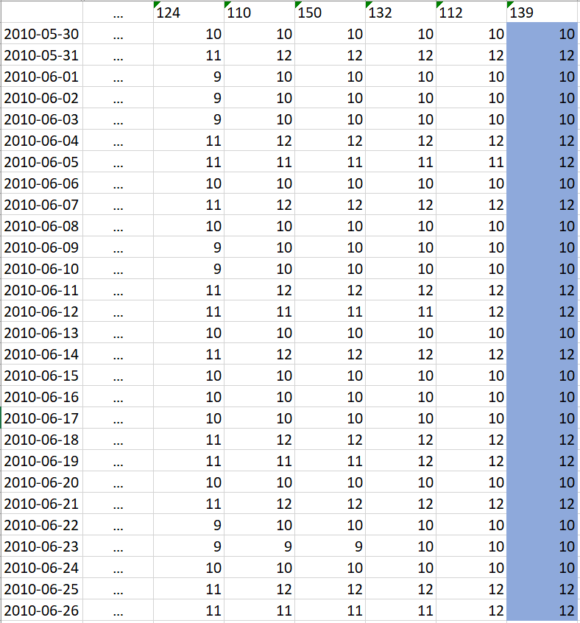
What size of equipment should be used
Expected number of equipment needed from May 30th to June 26th:
53 ft trailer: 10~12

Slide 24
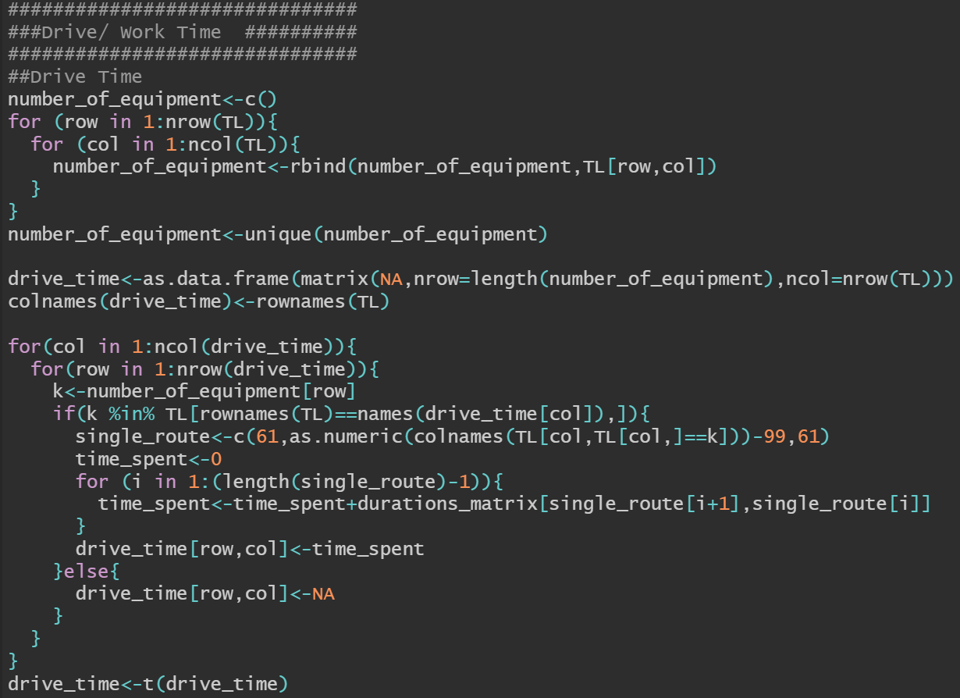
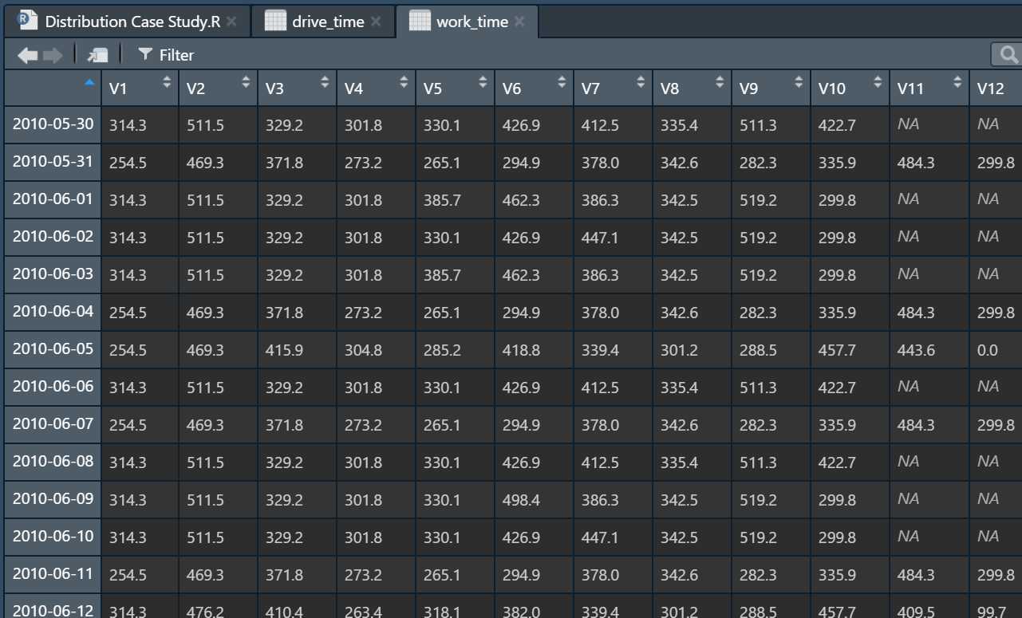
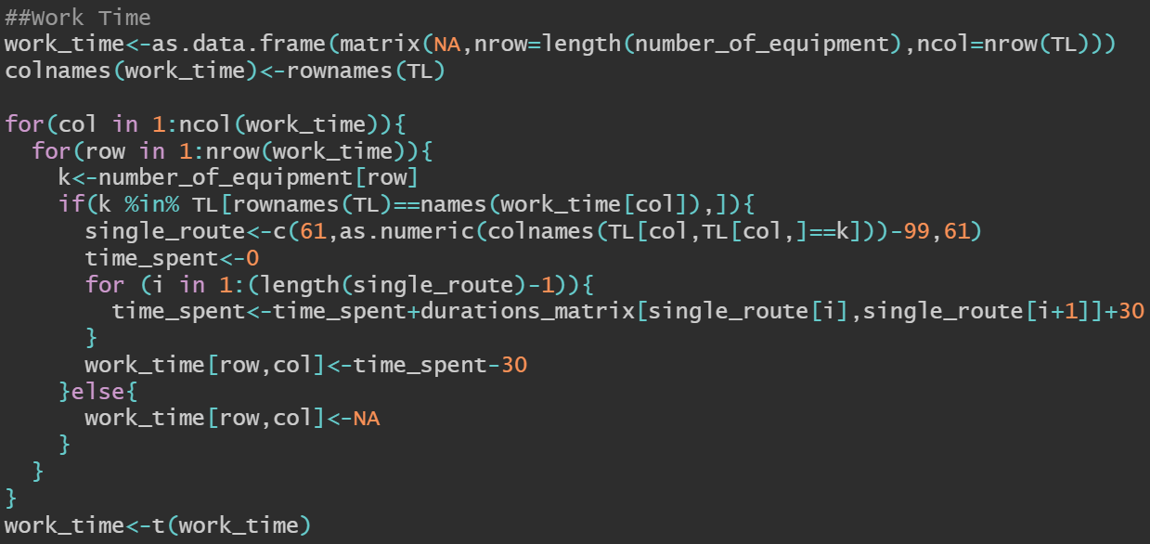
Truckload Driving/Working Time
Notice: Due to the 9 hours work time constraint, each 12 trailer has work time restricted under 540 minutes

Slide 25
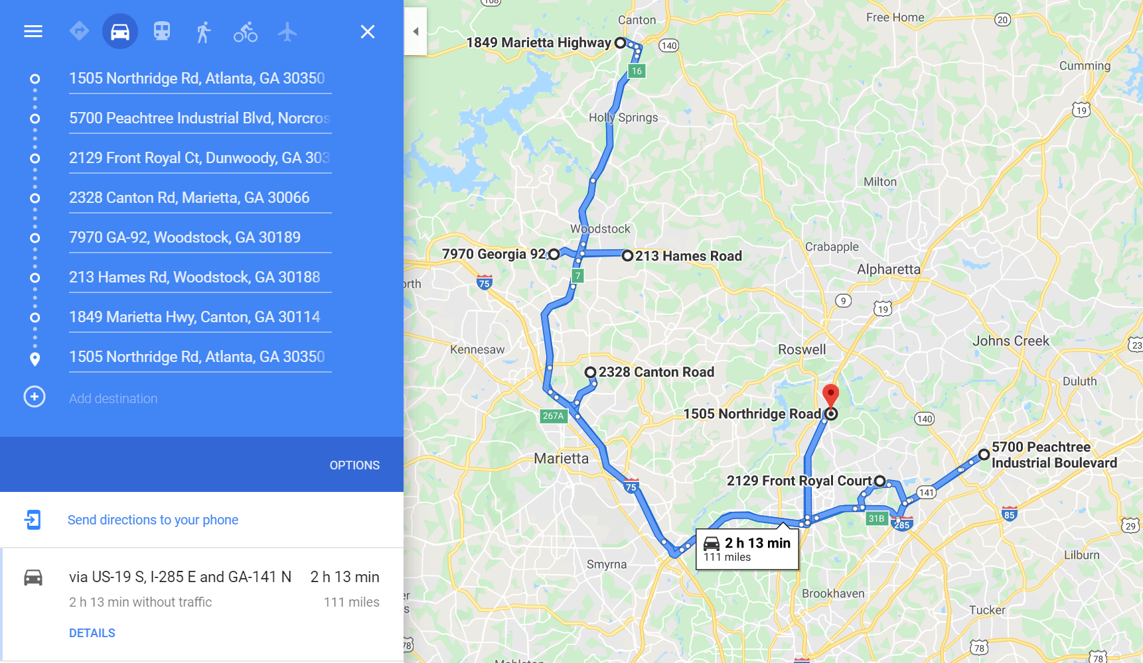
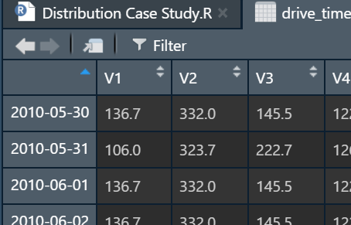
Double Check the Truckload Driving time with Google Map

Slide 26
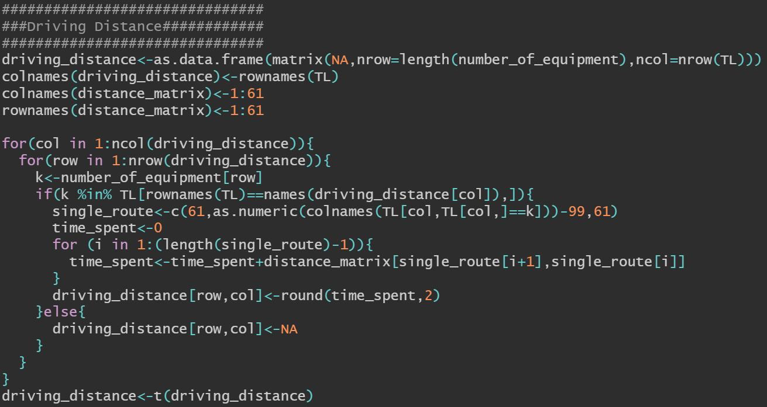
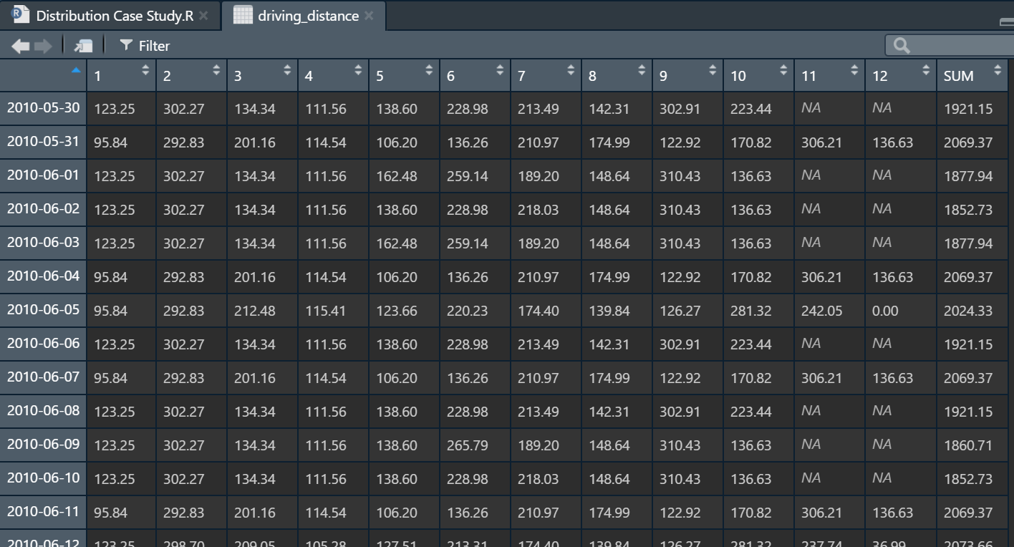
Driving Distance Report

Slide 27
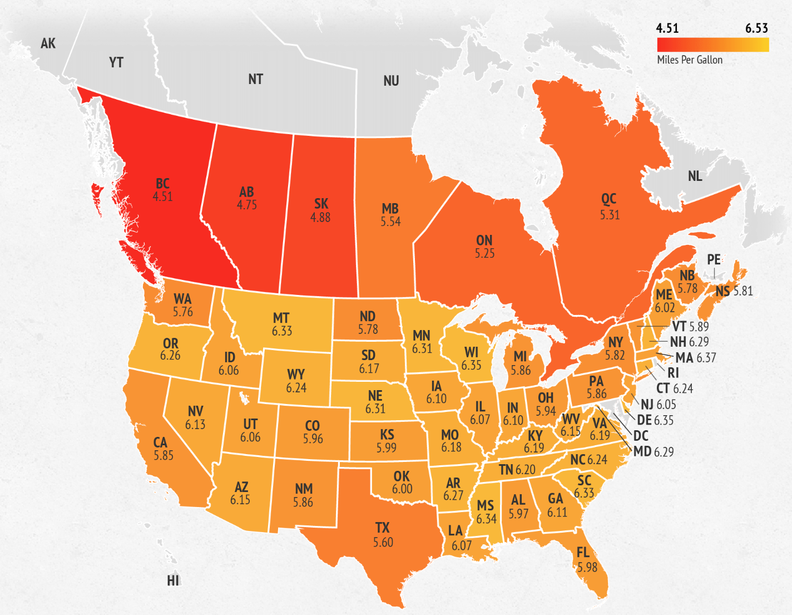
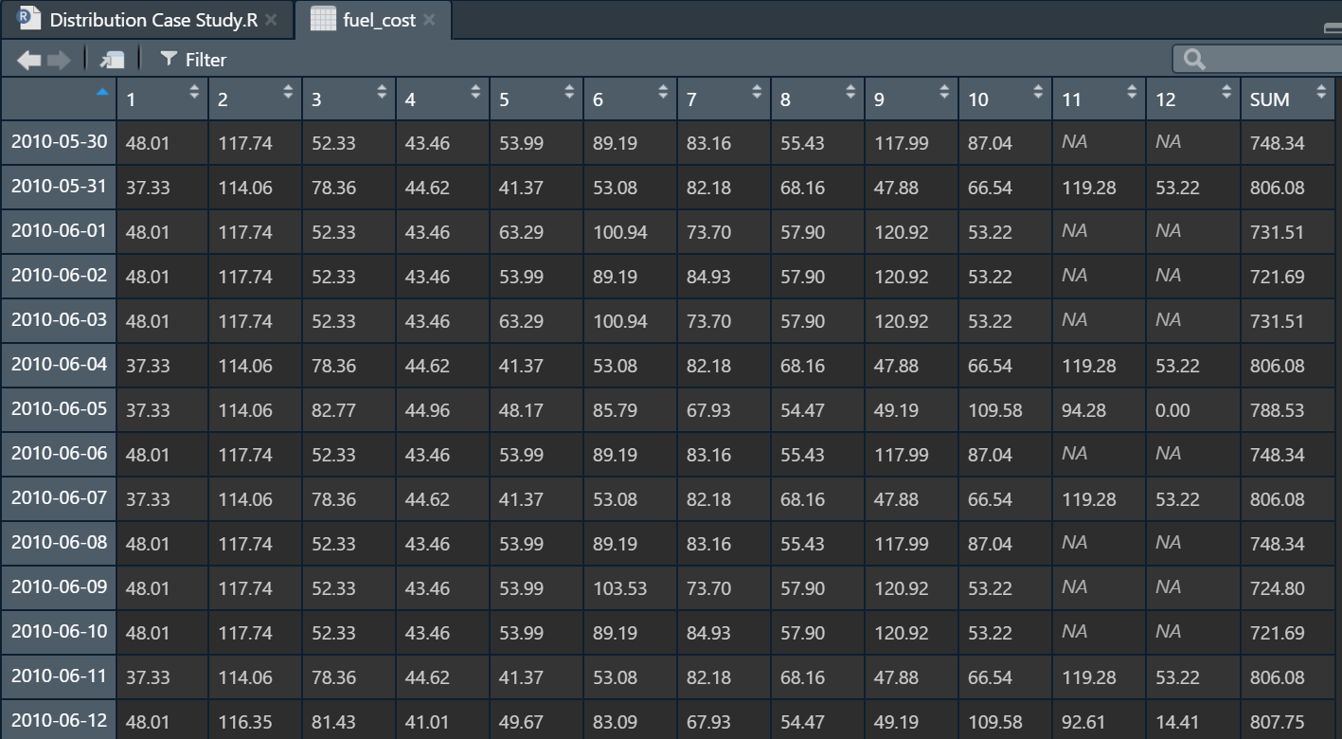
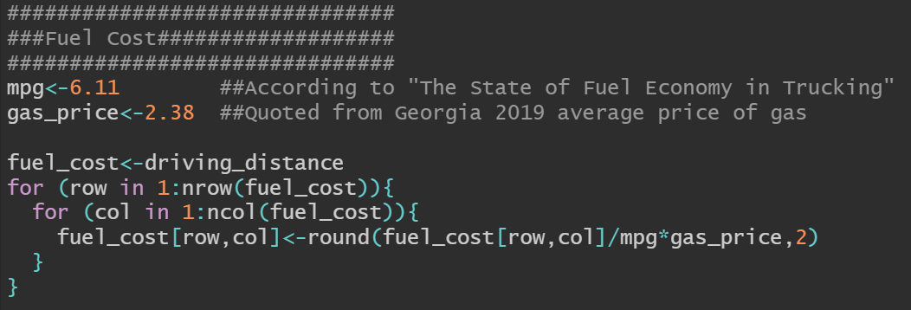
The State of Fuel Economy in Trucking
The State of Fuel Economy in Trucking

Slide 28
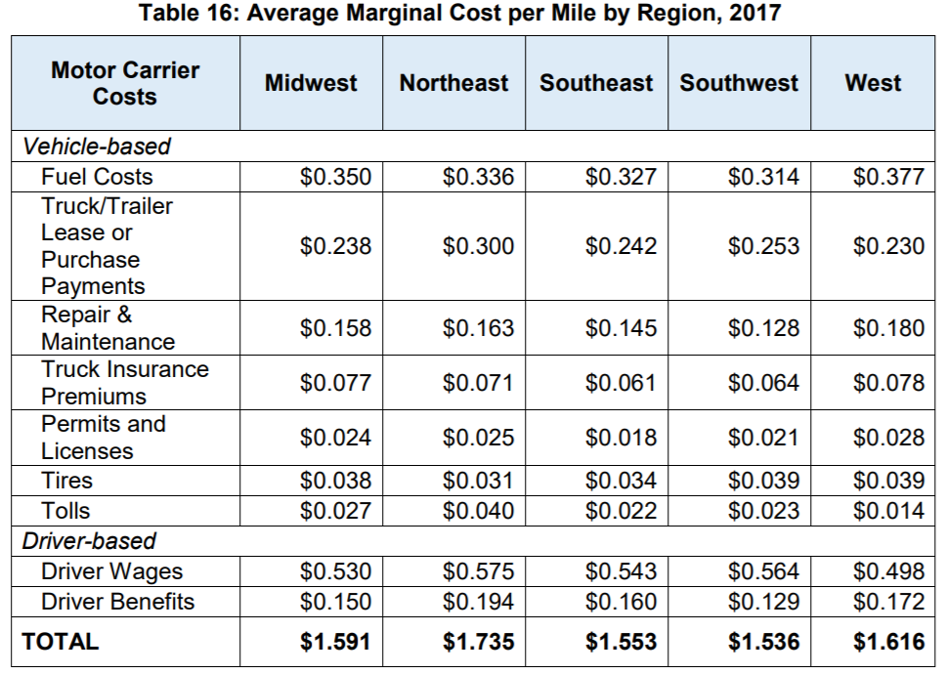
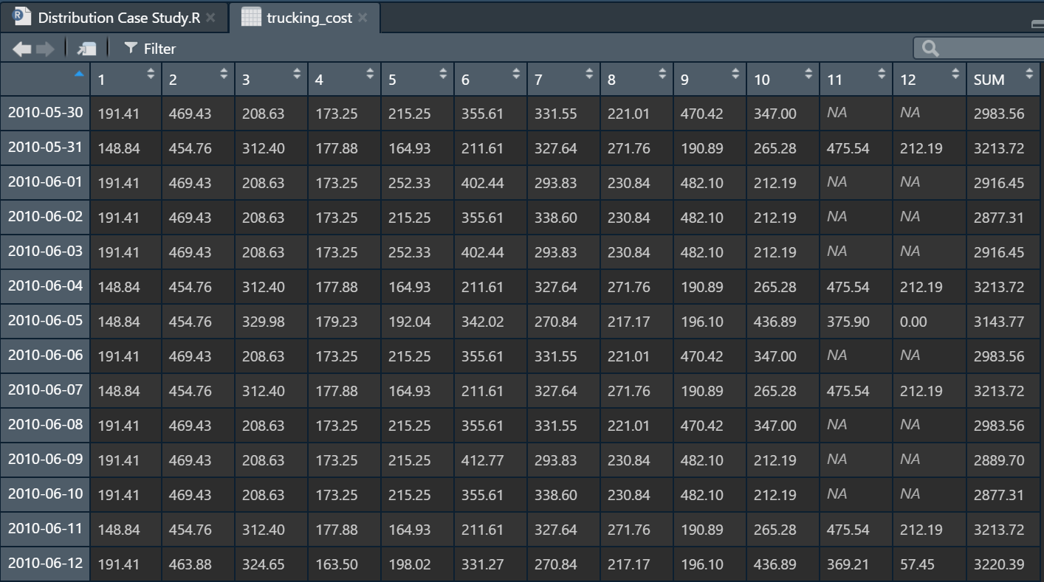

Trucking Cost Report
From “ATRI Analysis of the Operational Costs of Trucking: 2018 update”

Slide 29


Direct Labor (Headcount) Report
Assumption:
Unloading: 500 cases per hour per captia
Loading: 40 pallets per hour per captia
Sorting: 150 cases per hour per capita
Shift hour: 8 hour night shift
Utilization rate: 80%

Slide 30


Total Cost Report
Assumption:
$15 hourly wage

Slide 31

Generating Reports in Excel sheet
Route_Plan
Drive_Time
Work_Time
Driving_Distance
Fuel_Cost
Trucking_Cost
Total Cost

